Slide 1

recyclING plastic
from electronic waste

Slide 2
Recycling plastic from electronic waste
recyclING plastic from electronic waste
Industrial electric motors, computers, smart phones and much more are all electronics,
and in their end-of-life electronic waste.
There are lots of plastic in electronics. Recycling it into valuable raw material means
taking care of the plastic in a proper way.

Slide 3
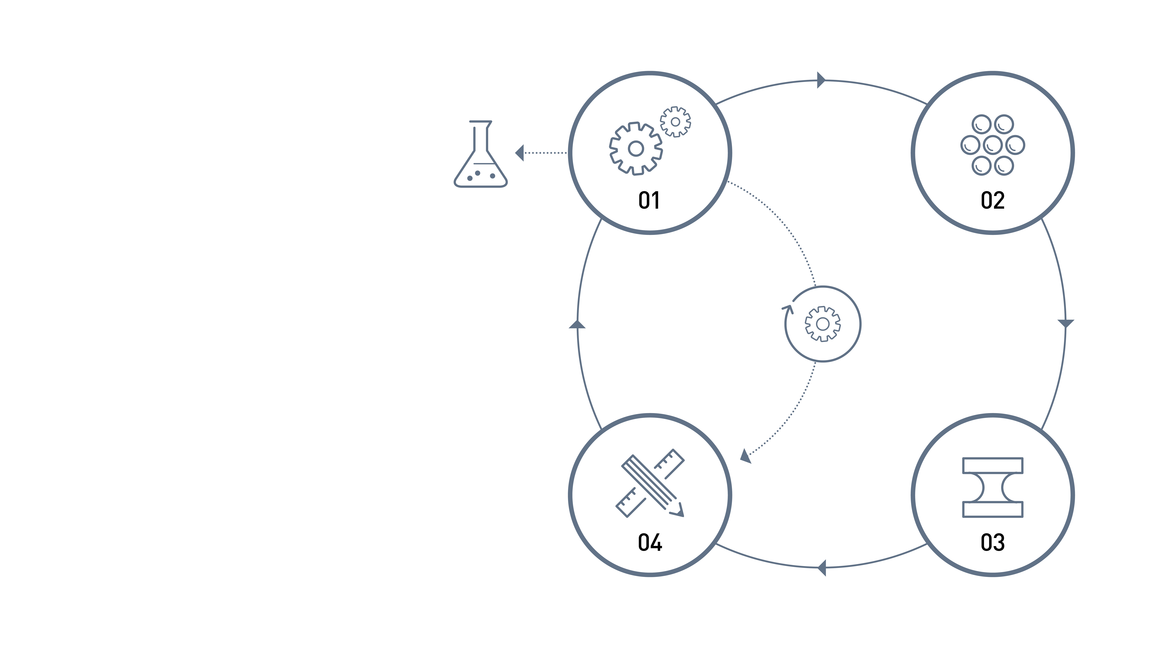
recyclING plastic from electronic waste
Overview of the steps
in the process
01. General recycling
Hazardous waste / Reuse /
Mechanical treatment / Extraction of plastic
02. Plastic refining
Washing / Refining / Separation
03. New raw material
Analysis and allocation
04. New products

Slide 4




recyclING plastic from electronic waste
01
GENERAL RECYCLING
Hazardous waste
Reuse
Mechanical treatment
Extraction of plastic

Slide 5



recyclING plastic from electronic waste
02
PLASTIC REFINING
Washing
Refining
The extracted plastic is taken to the plastic process.
After the plastic is shredded, it’s washed and further
refined. And separated into the different types of plastic.
Separation

Slide 6

recyclING plastic from electronic waste
03
NEW RAW MATERIAL
The end plastic raw material is PP/PE flakes and PS and ABS granulates;
small bits of pure plastic. The quality of the recycled plastic is continuously
tested in the facility’s own laboratory.
The plastic is after testing delivered as new raw material to, for example,
the electronics industry.

Slide 7

recyclING plastic from electronic waste
04
NEW PRODUCTS
By now, the plastic is ready to be part of new products,
often new electronics. And the loop is closed.

Slide 8



